Slide 1
A Vision of Knowledge Organization Panel in Honor of Ingetraut Dahlberg
Panelists: H. Peter Ohly, Axel Ermert, Michael Kleineberg, Marcia Zeng, Rosa San Segundo, Claudio Gnoli, Rick Szostak, Birger Hjørland, Joe Tennis, Richard Smiraglia, M. Inês Cordeiro, Jiří Pika

Slide 2
Dr. Ingetraut Dahlberg Ϯ 24.10.2017
1927, 20th February born as Ingetraut Gessler in Cologne, Germany
studied Philosophy, Catholic Theology, English Studies and Physics
1962/63 Scientific Documentalist
1964/65 head of the DGD Library and Documentation Center, Frankfurt
1967-1969 at FID chair of Revision Committee UDC-03/04 (Common auxiliaries of materials and Common auxiliaries of relations, processes and operations)
1973 Doctor of Philosophy PhD (dissertation => Grundlagen universaler Wissensordnung, 1974)
1974 Founding Editor of journal International Classification IC (1993 => Knowledge Organization KO )
1977 Gesellschaft für Klassifikation (GfKl, German Society for Classification)
1979 INDEKS publishing house (1997 => part of ERGON, 2017 => part of NOMOS)
1989 International Society for Knowledge Organization (ISKO)
2014 Book „Wissensorganisation: Entwicklung, Aufgabe, Anwendung, Zukunft“ (Knowledge Organization: Development, Task, Application, Future)
Panelist: Peter Ohly

Slide 3
10 Desiderata for KO
Recognize concepts/knowledge units and analyze their essential. characteristics, in order to create KOS. Identify the main scope of ordering systems. a) Elaborate a teaching curriculum for the various KO activities, together with titles of qualification of different professionals. b) Establish an own Academy. Nationally and internationally, a paid secretariat should be employed, to raise professionalism. Elaborate an ordering system of all KO-relevant concepts to serve as a model for other knowledge fields. | Establish national KO institutes for the elaboration of KOSs, attached to research institutions. KO experts should act on the public plane, e.g. as consultants, editors. The General Secretariat should collaborate with all the experts in the national chapters. Intensify the promotion of knowledge about KO through publications. a) KO should become an independent autonomous discipline under the Science of Science. b) Classification systems should not be implemented as discipline-oriented. See: Information Coding Classification (ICC), based on general object areas.
Panelist: Peter Ohly

Slide 4
Panel Topics
1. | Cf. Desideratum | Main Panelists | Commentators
I. Knowledge units | 1 | A. Ermert | M. Kleineberg
II. KOSs types | 2 | M. Zeng | R. San Segundo
III. The logic of ICC | 10 | C. Gnoli | R. Szostak
IV. KO as Science of Science | 5, 10 | B. Hjørland | J. Tennis
V. KO formation and environment | 3-4, 6-9 | R. Smiraglia | M. I. Cordeiro
Panelist: Peter Ohly

Slide 5
General Introduction | (7 Min)
Topics I – V (Introductions) | 35 Min.
Topics I – V (Comments) | 25 Min.
Open Forum Discussion/ Further Topics | 15 Min.
Open Floor Discussion | 15 Min.
Final Synopsis | 8 Min.
 | 105 Min.
Panelist: Peter Ohly

Slide 6
I. Knowledge units
Theory of the concept (the Concept Triangle)
A Item of reference (Referent)
B Characteristics (necessary verifiable statements)
C Verbal form (designation)
Panelist: Axel Ermert

Slide 7
What is a Concept?
Concept: „unit of thought“ (= subjective ?)
Concept: „unit of knowledge“ (= objective)
„A concept is a knowledge unit, comprising verifiable statements about a selected item of reference, represented in a verbal form.“
______________________________________________
Many of ID‘s ideas are also reflected in the international standards‘ process, like ISO 704 or ISO 1087. Both, ID and ISO, draw on Eugen Wüster (first work published 1932).
Panelist: Axel Ermert

Slide 8
Concepts …
based on „true statements“ about the „item of ref.“ and on its „necessary characteristics“
preferably expressed in a definition (with the same elements)
general, special, and individual concepts
can be formed, and exist, independent of the relative term(s)
Panelist: Axel Ermert

Slide 9
Concepts …
express ‚noematic knowledge‘ (preceded by ‚noetic knowledge‘, ie. the psychological procedure of becoming conscious, i.e. arriving at this ‚noem. knowledge‘)
express, and are based on, concept relationships:
formal relations (identity; inclusion .. ); categorial relations (entities: abstract; .. ; properties: quantity; ..; activities; ..; dimensions: time; space; .. ); contents-related relations:
- generic relation („is a“); partitive relation („is part of“); opposition / complementary relation; functional relation
Panelist: Axel Ermert

Slide 10
The role of definitions
Concepts – preferably expressed by definitions (always depending on the purpose)
many types of definitions:
- nominal definitions (explaining ‚the word/term‘, not ‚the thing/concept‘)
- ostensive definitions (just ‚pointing‘ from term to referent)
- real (‚conceptual‘) definitions (explaining/defining ‚the thing/concept‘):
(generic; partitive; opposition; functional), ie. referring to the conceptual substance of the item of reference
Panelist: Axel Ermert

Slide 11
Terminology corpora
Aim: Creating a corpus of definitions [a concept system]. Create also such a corpus as a basis of Knowledge Organization (incl. the Classification terminology)
Use, e.g., the 3 following existing corpora:
ISO 5127:2001 „Vocabulary of inf. and doc.“
British Standard BS DD 247 „Documentation – Vocabulary“
German „Terminologie der Inform. und Dok. (TID) – 1975/2006“
Panelist: Axel Ermert

Slide 12
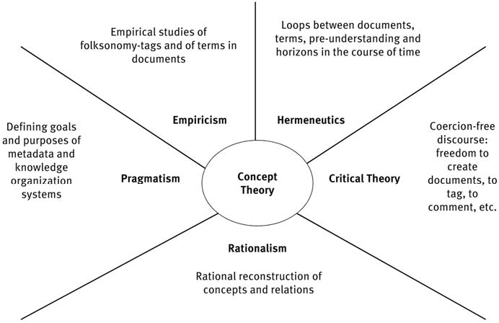
I. Knowledge units (co-statement)
Co-Panelist: Michael Kleineberg

Slide 13
II. KOSs types
Towards a uniform, yet universal, ordered representation of human knowledge
Panelist: Peter Ohly
Co-Panelist: Marcia Zeng

Slide 14
10 Desiderata for KO
Recognize concepts/knowledge units and analyze their essential characteristics, in order to create KOS. Identify the main scope of ordering systems. a) Elaborate a teaching curriculum for the various KO activities, together with titles of qualification for different professionals. b) Establish an own Academy. Nationally and internationally, a paid Generals Secretariat should be employed to raise professionalism. Elaborate an ordering system of all KO-relevant concepts to serve as a model for other knowledge fields. | Establish national KO institutes for elaboration of KOSs, attached to research institutions. KO experts should act on the public plane, e.g. as consultants, editors. The General Secretariat should collaborate with all experts in the national chapters. Intensify the promotion of knowledge about KO through publications. a) KO should become an independent autonomous discipline under the Science of Science. b) Classification systems should not be implemented as discipline-oriented. See: Information Coding Classification (ICC), based on general object areas.
Co-Panelist: Marcia Zeng
Notes:
I would like to start with her first desired objective, to “Recognize concepts/knowledge units and analyze their essential characteristics, in order to create KOS”. This also led to her commitment to the creation of a new universal classification system or upper ontology.

Slide 15
KOS Types based on Classification System for Knowledge Organization Literature
Originally compiled by Ingetraut Dahlberg [1974; republished in "KO", 20 (1993), n. 4, p. 211-222], with minor additions by later literature editors G Riesthuis and IC McIlwaine
http://www.isko.org/scheme.php
0 Form Divisions
1 Theoretical foundations and general problems
2 Classification Systems and Thesauri, Structure and Construction
3 Methodology of Classing and Indexing
4 On Universal Classification Systems and Thesauri
5 On Special Objects Classifications (taxonomies)
6 On Special Subjects Classifications and Thesauri
7 Knowledge Representation By Language and Terminology
8 Applied Classing and Indexing
9 Knowledge Organization Environment
In:
Logic, Mathematics and other Formal Sciences
Physics, Chemistry, Electronics, Energy
Astronomy, Geosciences, Geography, Mining
Biological, Veterinary Science, Agriculture, Food Sciences, Ecology
Human Biology, Medicine, Psychology, Education, Labour, Sports, Household
Sociology, Politics, Social Policy, Law, Area Planning, Military Science, History
Economy, Management Science, Mechanical Engineering, Building, Transport[ation]
Science of Science, Information Science, Computer Science, Communication Science, Semiotics
Language, Literature, Music, Arts, Philosophy, Religion
Co-Panelist: Marcia Zeng
Notes:
Classification System for Knowledge Organization Literature was originally compiled by Ingetraut Dahlberg [1974; republished in "KO", 20 (1993), n. 4, p. 211-222], with minor additions by later literature editors G Riesthuis and IC McIlwaine. The full system can be found on the ISKO website.
http://www.isko.org/scheme.php
Note among the main classes and sub-classes, the classification systems can be found in three main classes, 4, universal classification systems, 5, special objects classifications which she considered as taxonomies, and 6, special subjects classifications. On the right side are the domains found in common classes that are further divided based on the themes or domains.
Note that she considers the classifications for objects as taxonomies, and are not the same as those for special subjects.

Slide 16
KOS Types discussed by Ingetraut Dahlberg in her 2017 Brief Communication article
Ref: Dahlberg, Ingetraut. 2017. Brief Communication: Why a New Universal Classification System is Needed. Knowledge Organization. 44(1): 65-71. Section 6.0.
KOS Types
Unification efforts
Classification systems (with notations/digits)
Enumerative, Faceted
Universal, special
Subject headings
Thesauri
-- individual thesauri
-- super-thesauri (large size)
Ontologies
-- domain ontologies / lower ontologies
thousands occurred in the 21st century
-- upper ontologies
-- common ontology
Has sufficient details to precisely specify meanings of terms and concepts in domain ontologies
Is a compatible subset of all the linked upper ontologies
a universal classification system
cross-walks
Universal Source Thesaurus
macro-thesaurus
integrated thesaurus
super-thesauri
super-ontologies
a universal knowledge ordering system
Co-Panelist: Marcia Zeng
Notes:
Ref: Dahlberg, Ingetraut. 2017. Brief Communication: Why a New Universal Classification System is Needed. Knowledge Organization. 44(1): 65-71. Section 6.0.
In her most recent article, Brief Communication: Why a New Universal Classification System is Needed, published in Knowledge Organization in 2017, she gave a review of the history of KOS development in the modern history. Each wave of these efforts also introduced the need for unification.

Slide 17
A new universal classification system
Aims to establish compatibility between the major universal classification systems in use.
Believing that classification systems should not be implemented as discipline-oriented.
Developing Information Coding Classification (ICC) [cited by Dahlberg 1982-2017]
Realizing a new approach, based on general object areas, arranged according to the principle of evolution.
Towards a uniform, yet universal, ordered representation of human knowledge
Proposing to switch between 6 universal classification systems in use.
ICC
DDC
UDC
LCC
BC
CC
Ref: Dahlberg, I. - Classification structure principles : Investigations, experiences, conclusions. In: Structures and Relations in Knowledge Organization : Proceedings of the 5th International ISKO Conference 25-29 August 1998 Lille, France. Würzburg : Ergon Verlag, 1998, p.80-88.
Co-Panelist: Marcia Zeng
Notes:
Dahlberg, I. - Classification structure principles : Investigations, experiences, conclusions (Lang.: eng). - In: Structures and Relations in Knowledge Organization : Proceedings of the 5th International ISKO Conference 25-29 August 1998 Lille, France. Würzburg : Ergon Verlag, 1998, p.80-88.
Aims to establish compatibility between the major universal classification systems in use.
Believing that classification systems should not be implemented as discipline-oriented. [The classifications line DDC, RVK (relying on LCC), were based on book themes corresponding to the principles of ‘literary warrant’, which means that only themes which occur in literature .]
Developing Information Coding Classification (ICC)
Realizing a new approach, based on general object areas, arranged according to the principle of evolution.
Towards a uniform, yet universal, ordered representation of human knowledge
ICC was designed as a theoretical superstructure of a universal system and the author proposed its use as a switching mechanism between the five widely used classification systems:
Dewey Decimal Classification (DDC), Universal Decimal Classification (UDC); Library of Congress Classification (LCC), The Bliss Bibliographic Classification (BC) and Colon Classification (CC).

Slide 18
A universal ontology “A completely innovative universal classification system: ICC”* which delivers it as an upper ontology
Ontological basis – nine “levels of being”
1. Form and structure;
2. Energy and matter;
3. Universe and Earth;
4. Biological life sciences;
5. Human beings and life;
6. Social beings and life;
7. Material products—economy and technology;
8. Intellectual products—knowledge and information;
9. Spiritual products—culture and humanities;
non-living ‘matter’
6,500 knowledge fields being defined.
Combination of
Concepts of ontical level objects (Ontical refers to a particular area of Being)
& categorical concepts and its subdivisions
living organisms
products of man and society
*Ref: Dahlberg, Ingetraut. 2017. Brief Communication: Why a New Universal Classification System is Needed. Knowledge Organization. 44(1): 65-71. Section 6.0.
Co-Panelist: Marcia Zeng
Notes:
Ingetraut Dahlberg describes her Information Coding Classification (ICC) as consisting of nine general object areas according to the principle of evolution (Dahlberg, 1998). Our next speaker, Claudio Gnoli, will give more details about this ICC.
These nine areas have an evolutionary sequence and an internal structure of 3 x 3:
areas 1 to 3 deal with non-living matter,
4 to 6 are about living organisms, and
7 to 9 are products of man and society: material, intellectual and metaphysical “artifacts.”
When further specifying the contents of the nine areas, a series of aspects or facets are proposed. These facets can be applied on all levels of abstraction in a subject group or subject field.
When further specifying the contents of the nine areas, a series of aspects or facets are proposed.
General and theoretical concepts
Object-related concepts (also elements, parts, characteristics of objects, kinds of objects)
Activity-related concepts (states, processes, operations)
4-6. Concepts related to specialties of the objects and/or activities in facets 2 and 3
Concepts of influences on 2 and 3 from outside (‘instrumental’, technical relationship)
Concepts of the use of 2 and 3 in other fields (‘potential’, resource orientation, application relationship)
Concepts concerning the knowledge about 1 – 8 when it is distributed by persons, societies, documents, or used in educational purposes and in other kinds of applications (‘actualization’, synthesizing, environmental relationship) (Dahlberg, 1998).
These facets can be applied to all levels of abstraction in a subject group or subject field.

Slide 19
II. KOSs types. Critical aspects
Reality will always imply conceptual conventions,
and culture is found in the proper order of things
and said order of things is conceived as something which is imposed, which is given.
Panelist: Peter Ohly
Co-Panelist: Rosa San Segundo

Slide 20
II. KOSs types. . Critical aspects
The idea of organizing knowledge and the determinism in classification structures implicitly involve certain limits which are translated into a General Theory on the Classification of Knowledge,
given that classification responds to specific parameters and structures more than to a theoretical concept.
Panelist: Peter Ohly
Co-Panelist: Rosa San Segundo

Slide 21
II. KOSs types. Critical aspects
The classification of things is a reflection of their classification by man, and this is what determines classification structures.
The classification and organization of knowledge are presented to us as an artificial construct or as a useful fiction elaborated by man
Panelist: Peter Ohly
Co-Panelist: Rosa San Segundo

Slide 22
II. KOSs types. Critical aspects
Yet it is this perpetual obsolescence that makes our attempts at classification so dynamic.
There are many well-known theories which uphold that any total classification of knowledge will remain insufficient.
Panelist: Peter Ohly
Co-Panelist: Rosa San Segundo

Slide 23
II. KOSs types. Critical aspects
The new organization of knowledge points to a totally new conception; new epistemology has yet to be articulated.
There has been a leap from the invalidity of a general knowledge theory
The forthcoming millennium invades a new
organizational form of knowledge in the digital universe.
Rosa San Segundo

Slide 24
III. The logic of ICC
Information Coding Classification
inspired by Alwin Diemer (1970) for ID's PhD
presented in Bangalore (1977)
published (1982)
promoted by Dahlberg for all her life
applied by Ernesto W. DeLuca (2014)
Panelist: Claudio Gnoli

Slide 25
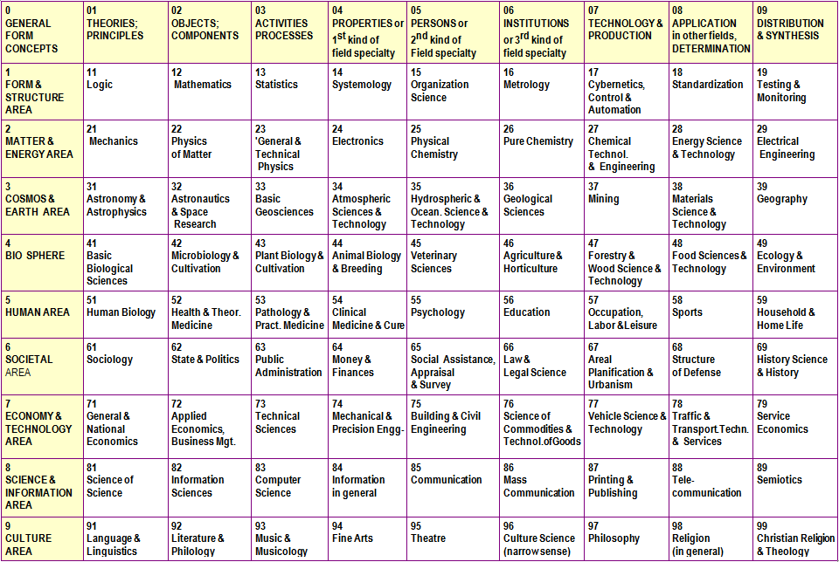
nine ontical
“levels of being”
[Hartmann]
non-disciplinary
Panelist: Claudio Gnoli

Slide 26
x nine
epistemic categories
...implicitly
disciplinary!
Recursive notation!
isko.org/cyclo/notation#4.4
Panelist: Claudio Gnoli

Slide 27
Panelist: Claudio Gnoli

Slide 28
8- science and information
-2 objects
82 information science
-23 activities on objects
823 information handling
My suggestion: -0 phenomena (ID didn't like the term)
80 documents
Panelist: Claudio Gnoli

Slide 29
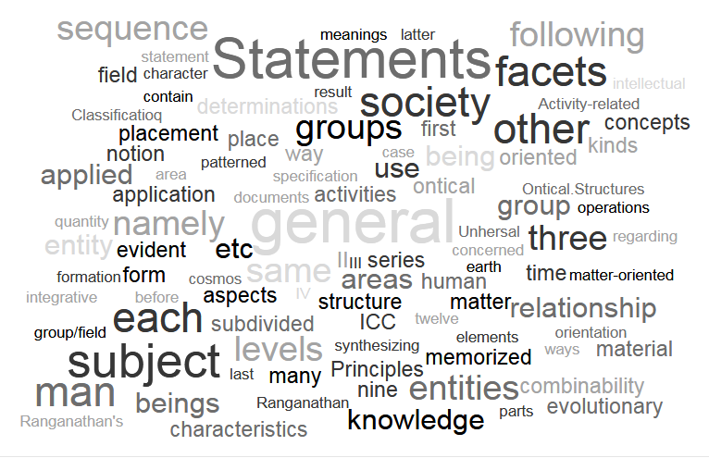
The logic of ICC (co-statement)
Panelist: Rick Szostak

Slide 30
IV. KO as Science of Science
Knowledge Organization as a Science of Science
Panelist: Birger Hjørland

Slide 31
Dahlberg‘ s KO
worked in different scientific domains.
Knowledge Organization: a science of science.
KO: independent science – but background in LIS.
separate from information science: terminology studies (–> Eugen Wüster)
Panelist: Birger Hjørland

Slide 32
Further key aspects
contributed to thesaurus development
Universal Classification
book series: Knowledge Organization in Subject Areas. (only one volume)
KO: too isolated in relation to classification in different domains (philosophers has succeeded far better)
important, to establish an interdisciplinary network and platform.
Panelist: Birger Hjørland

Slide 33
ISKO Encyclopedia of Knowledge Organization (IEKO)
a platform for
theoretical issues in classifications, indexing, big data etc.
for specific problems in each domain.
attracting leading researchers, e.g.
astronomical classification,
biological classification,
chemical and physical classification (e.g., the Periodical System),
language classification,
psychiatric classification
Panelist: Birger Hjørland

Slide 34
ISKO Encyclopedia of Knowledge Organization (IEKO)
not easy to make researchers contribute to our domain rather than their one
researchers will see the advantage
having all different domains and voices in one place,
open
motivating to contribute
meets visions of Ingetraut
Panelist: Birger Hjørland

Slide 35
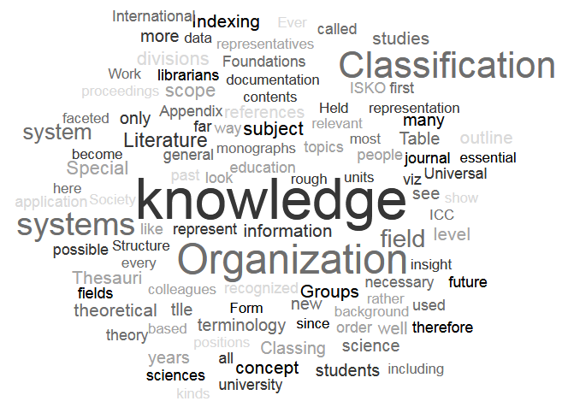
IV. KO as Science of Science (co-statement)
Panelist: Joe Tennis

Slide 36
V. KO formation and environment
10 Desiderata for knowledge organization (Dahlberg 2013):
• 1. …
• 2. Creating overviews of the classification systems.
• 3.1 A KO training curriculum.
• 3.2 ISKO academy.
• 4. Establish and finance a specialist.
• 5. …
• 6. National institutes of the Knowledge Organization.
• 7. ISKO experts as "points of contact".
• 8. Become members of the ISKO.
• 9. Publish the knowledge of its own area of knowledge.
• 10. …
Panelist: Richard Smiraglia

Slide 37
Knowledge Organization: A New Science
In Elements of Knowledge Organization (2014, 8) I wrote:
It takes some bravery to put your ideas before the critical eyes of peers, and it often ends with difficulty. Peers see what they want to see, and often miss critical points, no matter how carefully crafted. So it is a testimony to Dahlberg that she sought to turn the mostly rationalist/pragmatist act of classification into the science of the order of knowledge.
Panelist: Richard Smiraglia

Slide 38
Science is …
Ernst Nagel, in The Structure of Science (1979) contrasts science, the rigorous asking of questions, with common sense.
In a penultimate chapter “The Reduction of Theories” Nagel points out that most science leads to applications, which lose sight of the science behind them.
In The Nature of a Work that when I hinted that FRBR was developed “pragmatically,” that was code for “it was made up.”
I called for the structure of systems to handle instantiation based on empirical evidence.
Otlet (1934) observed,
“a science that is well made, is a system” …
“and a system is a classification”
This was exactly Dahlberg’s call to power to the ISKO community:
Base new classifications on the science of the order of knowledge
Panelist: Richard Smiraglia

Slide 39
In her various writings, she encouraged us to consider that:
1. Concept theory is the basic theory of knowledge organization;
2. Concepts are expressions of perceptions of subjective realities; and,
3. Our science must be the science of identifying all concepts, no matter the circumstances.
Panelist: Richard Smiraglia

Slide 40
Legacy of Science
She did pretty well, brave lady that she was.
She began a journal that now competes with JDoc, JASIST, IP&M and CCQ.
She began a society of scholars who now meet regularly.
She began a society of scholars whose regional conferences constantly challenge the intension of the domain.
Panelist: Richard Smiraglia

Slide 41
And, she left us the basics of theory, real theory:
“What is Knowledge Organization” (2014, 86)
True understanding of concepts has been jeopardized hitherto by the ignorance of their very nature, viz. that they form the constituents of any knowledge organization that also leads to the formation of classes. The linguistic aspect hinders most colleagues from perceiving the indispensable analytical aspect of concept formation and concept apprehension ….
Take any object, concrete or abstract, and figure out its essential characteristics by formulating “is”-statements. The synthesis of all thus determined characteristics under a name or a code depicts the object’s content in an abbreviated form and leads to designate the respective object.
The definition of a concept is therefore the resumé of content-determinant characteristics.
“ICC, Information Coding Classification” (1982, 87)
We distinguish … in an ontical sense between general entities. and general aspects, determinations of being. The general entities can be displayed in the following three ontical area groups of I) structure and matter; II) living beings; and, III) products of man (artefacts). These can be subdivided each into three general entity areas ( or "categories of being") … It is easy to see that there is an evolutionary series … and also that there is a division according to man's faculties … that the entities of the levels presuppose each other or contain each other in a natural sequence. The last three levels … show the same evolutionary series with respect to the products of man and society applied on a matter-oriented, intellect-oriented and mental-spiritual oriented level. Thus one can also say that the levels presuppose each other, they are “integrative.”
Panelist: Richard Smiraglia

Slide 42
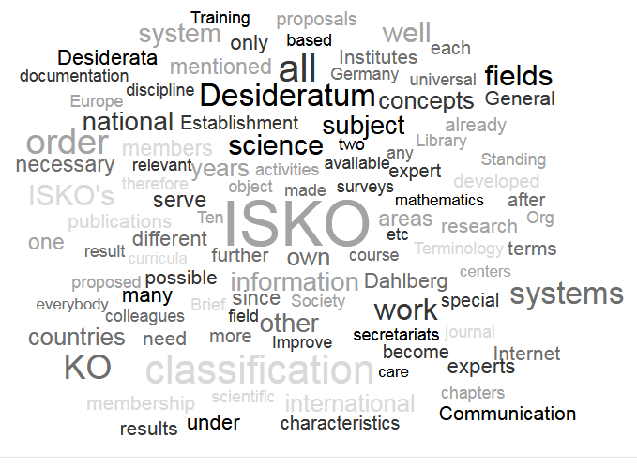
V. KO formation and environment (co-statement)
Panelist: Ines Cordeiro

Slide 43
V. KO formation and environment (co-statement)
10 Desiderata for knowledge organization (Dahlberg 2013):
By the end of her life Dahlberg left us with an ACTION PLAN
WHAT DOES IT MEAN ABOUT THE FIELD?
A call for more structured action to meet field needs:
2 Overviews of CS – Better knowledge of the field itself
3.1 KO curriculum - Improved education & training
3.2 ISKO academy - Expanded research
4. Establish and finance a specialist – Sustained development
5. Systematic order of all KO-relevant terms – Common structured language
6. National institutes of KO – Institutional channels
7. ISKO experts as "points of contact“ – Reinforced communication
8. Become members of the ISKO - Strengthen community
9. Publish the knowledge of its own area – Knowledge visibility and exchange
Panelist: Ines Cordeiro
Panelist: Ines Cordeiro

Slide 44
Further Topics/ Open Forum Discussion
I. Knowledge units /methods / linguistics
II. KOSs types
III. The logic of ICC
IV. KO encyclopedia /
KO as Science of Science
V. KO formation and environment

Slide 45
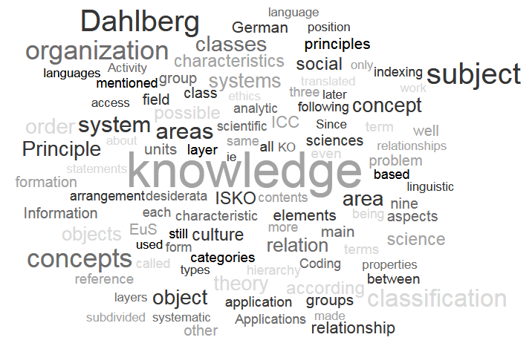
Open Floor Discussion

Slide 46
Final Synopsis
Panelist: Jiri Pika

Slide 47
Knowledge Organization: A New Science?!
Knowl. Org. 33(2006)No.1
Towards a
theory of the concept. Intern. Classification
(1974) No. 1, p. 12-19

